Slide 1
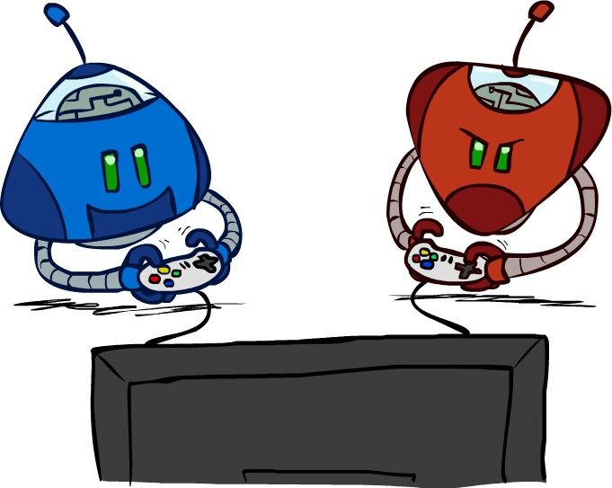
Artificial Intelligence (AI-2002)
Chapter 5: Adversarial Search

Slide 2
Content
• Adversarial Search
• Game Optimal Decision
• Min-max
• αβ-Pruning

Slide 3
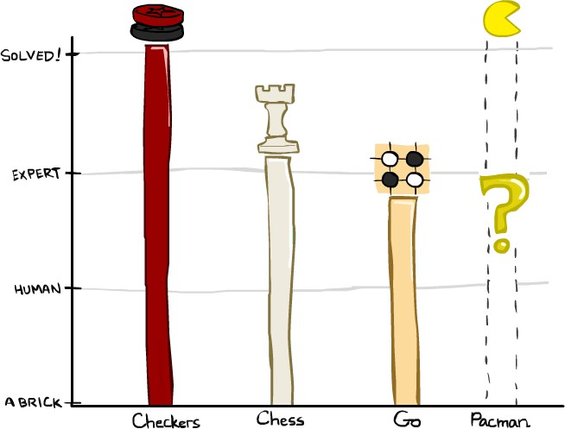

Game Playing State of the Art
Checkers:
1950: First computer player
1959: Samuel’s self-taught program
1995: First computer world champion beat 40 year champion Marion Tinsley *
2007: Checkers solved!
Chess:
1945-1960: Zuse, Wiener, Shannon, Turing, Newell & Simon, McCarthy. 1960-1996: gradual improvements
1997: Deep Blue defeats human champion Garry Kasparov 2024: Stockfish rating 3631 (vs 2847 for Magnus Carlsen)
Go:
1968: Zobrist’s program plays legal Go, barely (b>300!) 1968-2005: various ad hoc approaches tried, novice level 2005-2014: Monte Carlo tree search -> strong amateur 2016-2017: AlphaGo defeats human world champions
2022: Human exploits NN weakness to defeat top Go programs
Pacman

Slide 4
Adversarial Search
There might be some situations where more than one agent is searching for the solution in the same search space, and this situation usually occurs in game playing.
The environment with more than one agent is termed as multi-agent environment
Search in which two or more players with conflicting goals are trying to explore the same search space for the solution is called as an Adversarial search, often known as Games.

Slide 5
Types of Games in AI
Games are modeled as a Search problem and evaluation function, that helps to solve games.
Perfect information: A game with the perfect information is that in which agents can look into the complete board.
Imperfect information: Agents do not have all information about the game Deterministic games: Deterministic games are those games which follow a strict pattern and set of rules for the games.
Nondeterministic games: Non-deterministic are those games which have various unpredictable events
 | Deterministic | Non-deterministic
Perfect information | Chess, | Backgammon, monopoly
Imperfect information | Battleships | poker, scrabble

Slide 6
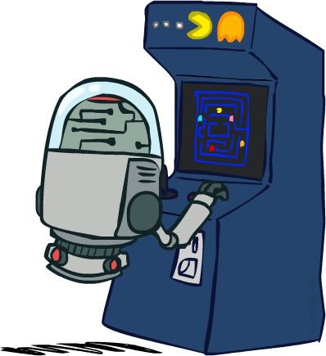
Deterministic Games
Many possible formalizations, one is:
  States: S (start at s₀)
  Players: P={1…N} (usually take turns)
  Actions: A (may depend on player/state)
  Transition function: S x A → S
  Terminal test: S → {true, false}
  Terminal utilities: S x P → R
Solution for a player is a policy: S → A

Slide 7
Zero-Sum Game
Zero-sum games are adversarial search which involves pure competition.
In Zero-sum game each agent's gain or loss of utility is exactly balanced by the losses or gains of utility of another agent.
One player of the game try to maximize one single value, while other player tries to minimize it.
General games
Agents have independent utilities
Co-operative, compete or indifference

Slide 8
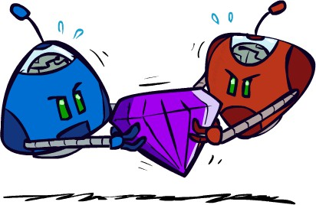
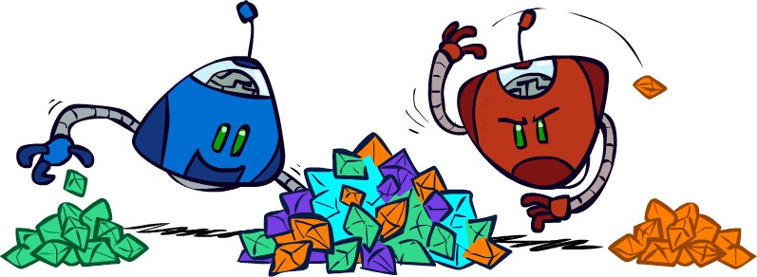


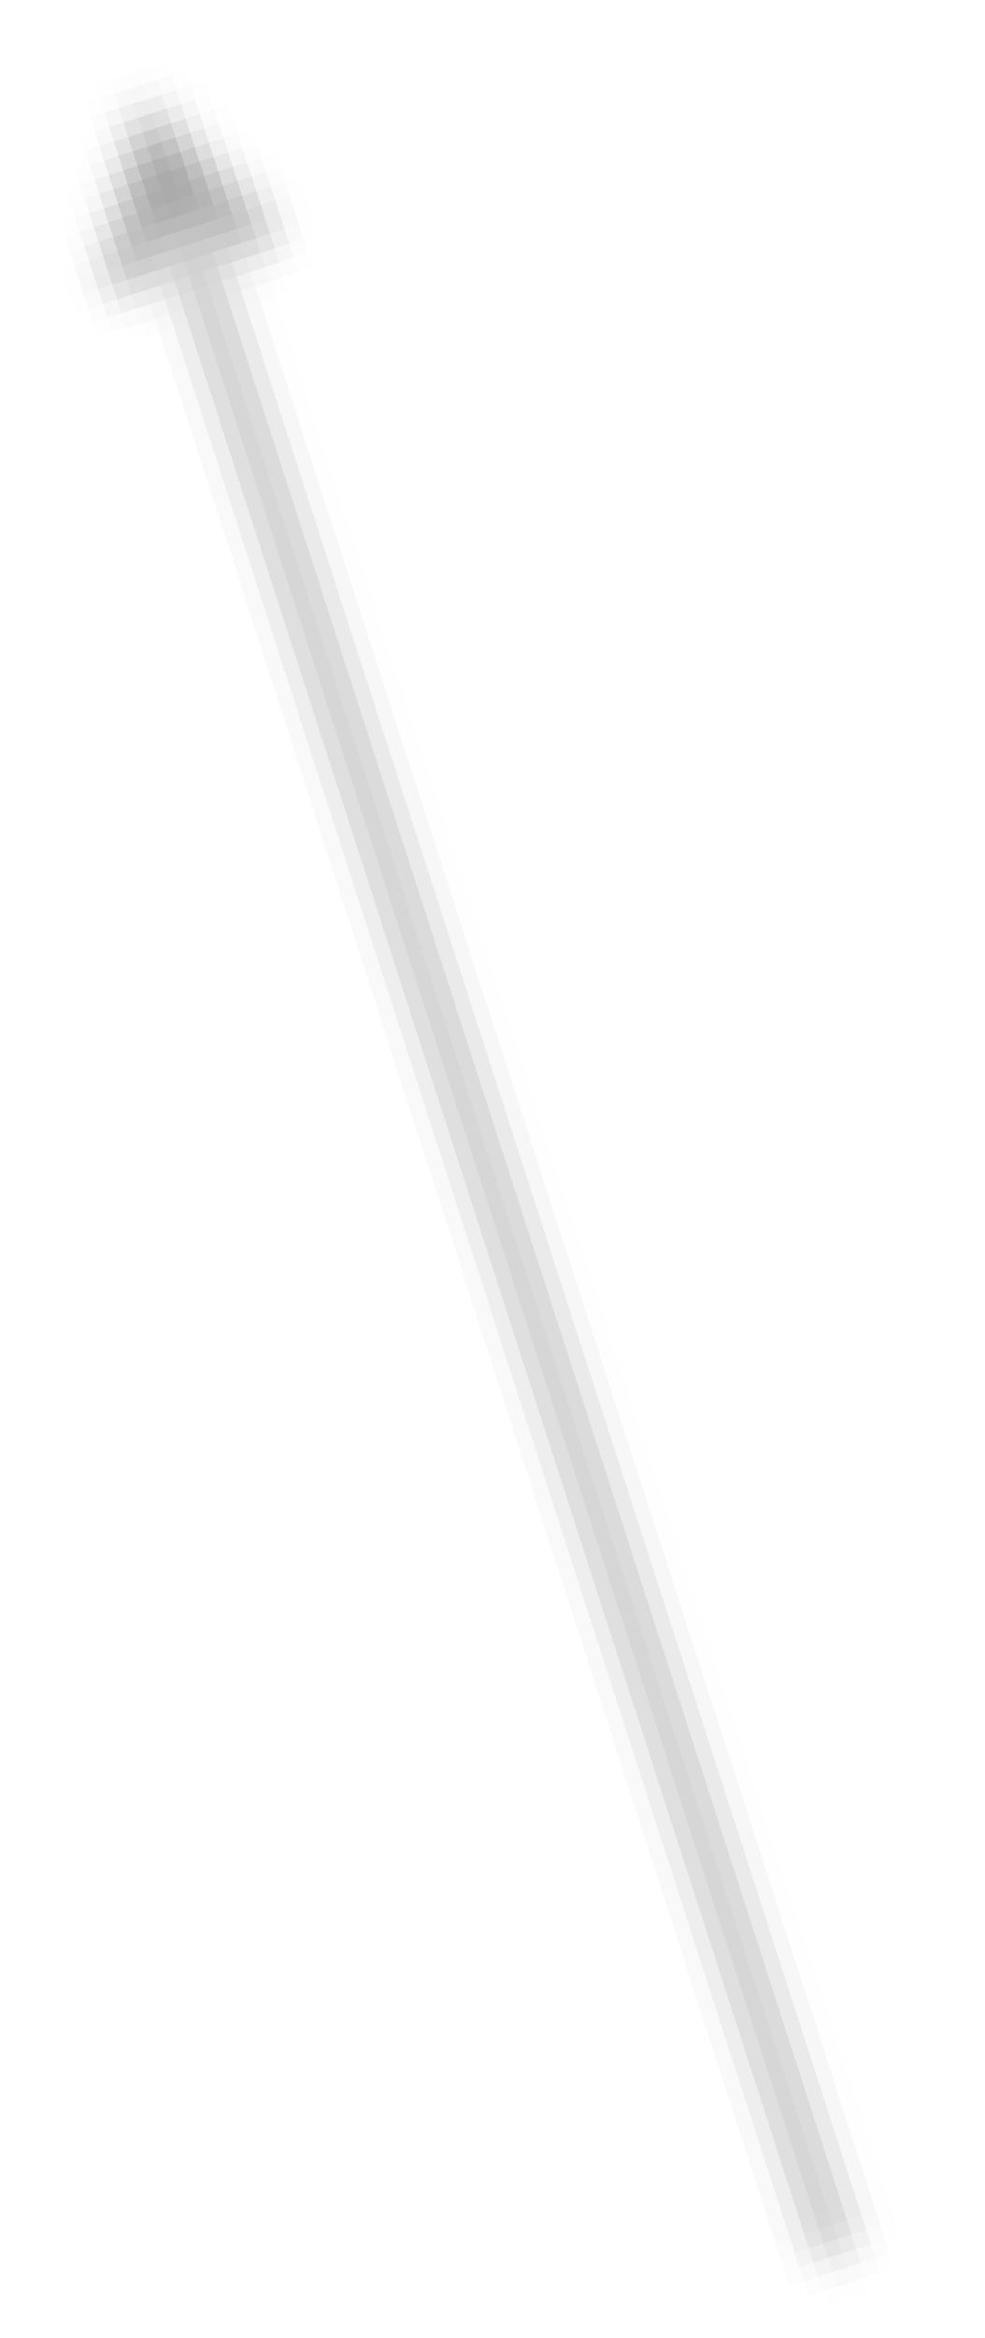
Zero-Sum Games
Zero-Sum Games
General-Sum Games
Agents have independent utilities (values on outcomes)
Cooperation, indifference, competition, shifting alliances, and more are all possible
Agents have opposite utilities (values on outcomes) Pure competition:
One maximizes, the other minimizes
▪
▪
▪
▪
Team Games
Common payoff for all team members

Slide 9
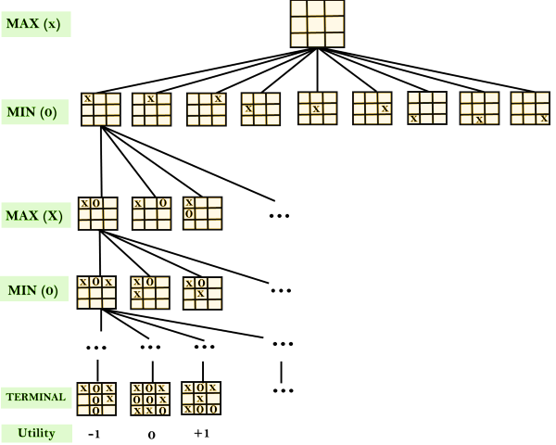
Game tree
A game tree is a tree where nodes of the tree are the game states and Edges of the tree are the moves by players. Game tree involves initial state, actions function, and result Function. (utility function)

Slide 10
Min-Max Algorithm
In this algorithm two players play the game, one is called MAX and other is called MIN.
Both the players fight it as the opponent player gets the minimum benefit while they get the maximum benefit.
Both Players of the game are opponent of each other, where MAX will select the maximized value and MIN will select the minimized value.
The min-max algorithm performs a depth-first search algorithm for the exploration of the complete game tree.
The min-max algorithm proceeds all the way down to the terminal node of the tree, then backtrack the tree as the recursion.

Slide 11
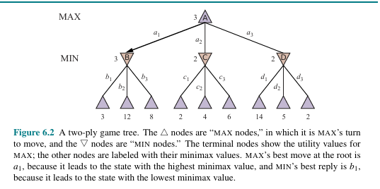

Slide 12
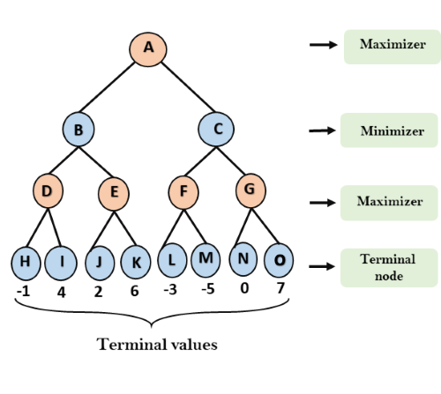
Min-Max Algorithm E.g.……..

Slide 13
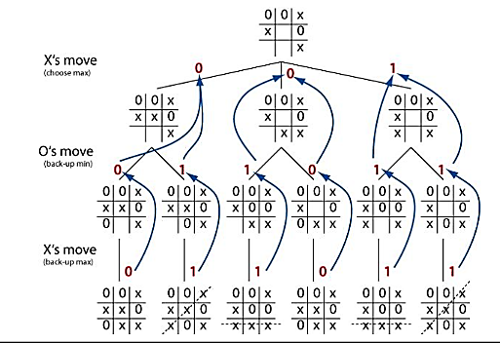
TIC-TAC TOE E.g.……..

Slide 14
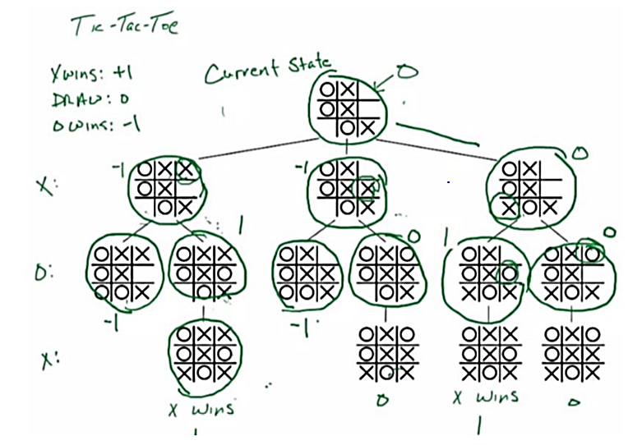

Slide 15
PLAYER(s) = O
Min-Value:
0
 | X | O
O | X | X
X |  | O
O | X | O
O | X | X
X |  | O
 | X | O
O | X | X
X | O | O
Max-Value:
1
Max-Value:
0
O | X | O
O | X | X
X | X | O
X | X | O
O | X | X
X | O | O
Value:
1
Value:
0

Slide 16
1
Max-Value:
 | X | O
O | X
X |  | O
PLAYER(s) = X
 | X | O
O | X | X
X |  | O
X | X | O
O | X
X |  | O
 | X | O
O | X
X | X | O
Min-Value:
0
Min-Value:
-1
Value:
1
O | X | O
O | X | X
X |  | O
 | X | O
O | X | X
X | O | O
X | X | O
O | X | O
X |  | O
X | X | O
O | X
X | O | O
Max-Value:
1
Max-Value:
0
Value:
-1
Max-Value:
0
O | X | O
O | X | X
X | X | O
X | X | O
O | X | X
X | O | O
X | X | O
O | X | X
X | O | O
Value:
1
Value:
0
Value:
0

Slide 17
9
5
3
9

Slide 18
Minimax
Given a state s:
  MAX picks action a in Actions(s) that produces highest value of Min-Value(Result(s, a))
  MIN picks action a in Actions(s) that produces smallest value of Max-Value(Result(s, a))

Slide 19
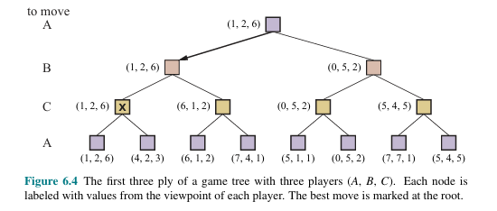
Optimal decisions in multiplayer games:

Slide 20
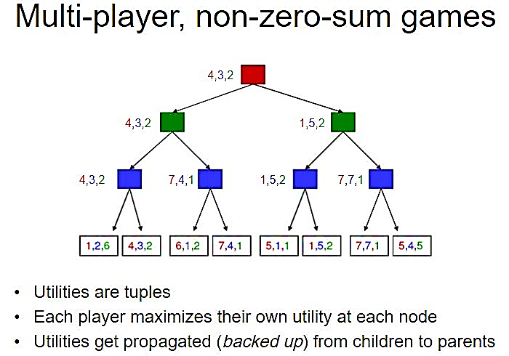

Slide 21
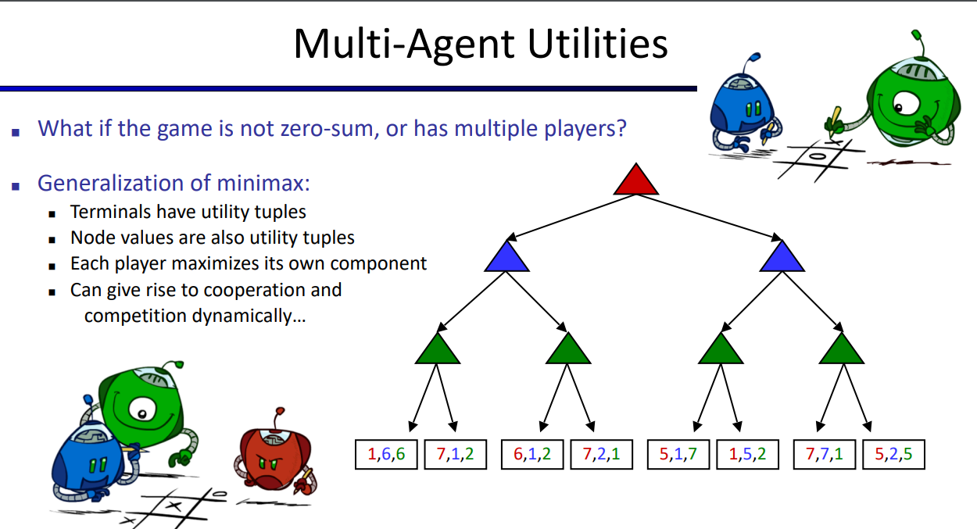

Slide 22
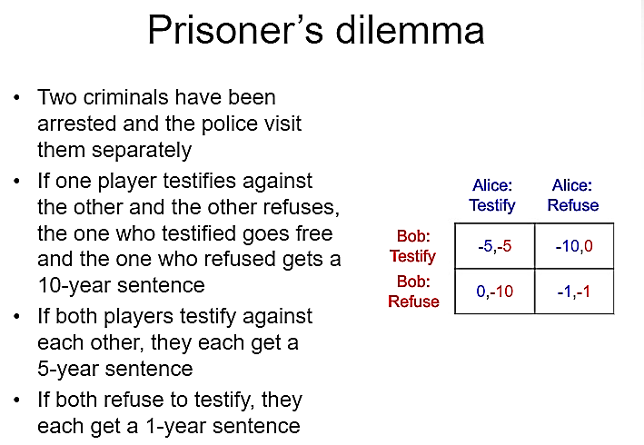
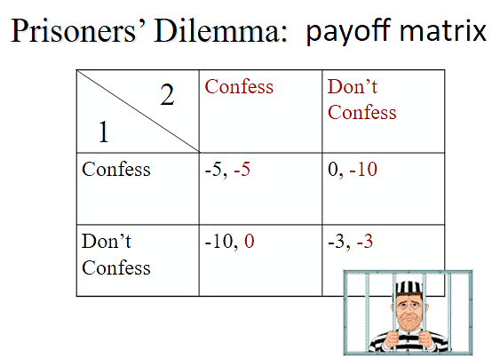
Abu-Bakr Abu-Bakr
Hasan
Hasan
3

Slide 23
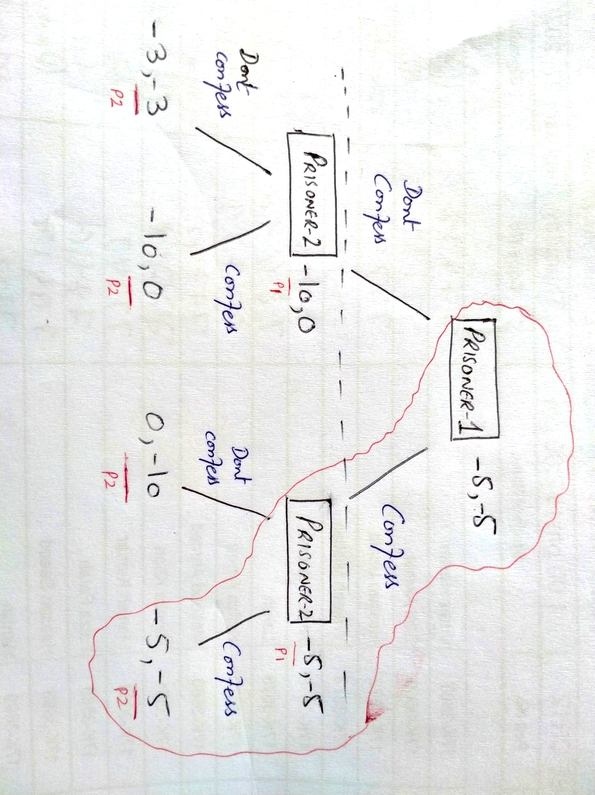
Prisoner’s Dilemma in Extensive Form

Slide 24
Properties of MiniMax algorithm:
Complete- Min-Max algorithm is Complete. It will definitely find a solution (if exist), in the finite search tree.
Optimal- Min-Max algorithm is optimal if both opponents are playing optimally.
Time complexity- As it performs DFS for the game-tree, so the time complexity of Min-Max algorithm is O(b^{d}), where b is branching factor of the game-tree, and m is the maximum depth of the tree.
Space Complexity- Space complexity of Minimax algorithm is also similar to DFS which is O (b^{d}),

Slide 25
Alpha Beta Pruning
It is an optimization technique for the min-max algorithm.
In minmax search, algorithm has to traverse all of the possible game states in depth of the tree i.e. O (b^{d}) to make decision.
α-β cuts off branches in the game tree which need not be searched because there already exists a better move available.
The two-parameter can be defined as:
α= the value of the best (i.e., highest-value) choice we have found so far at any choice point along the path for MAX.
β = the value of the best (i.e., lowest-value) choice we have found so far at any choice point along the path for MIN.

Slide 26
4
4
3
2
4
8
5
9
3
7
2
4
6

Slide 27
4
4
≤3
≤2
4
8
5
9
3
2

Slide 28
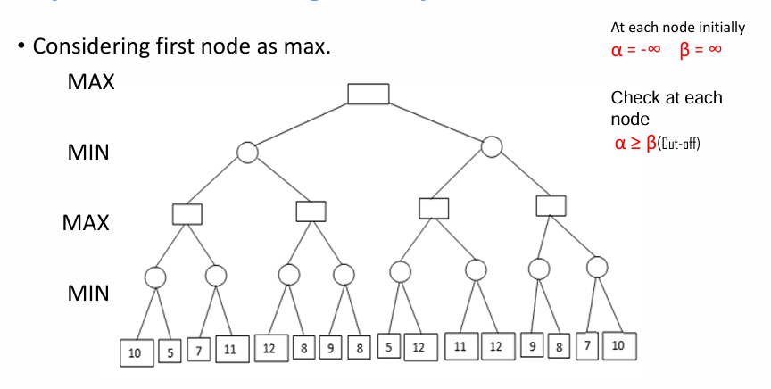
Alpha Beta Pruning example:

Slide 29
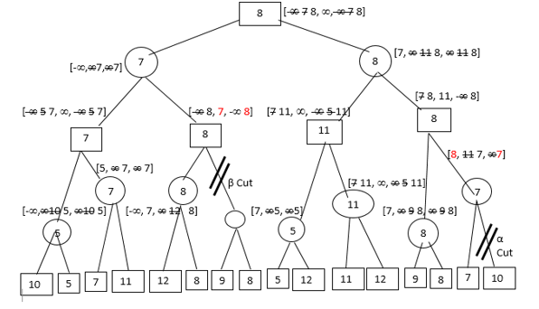
For MAX Nodes, V=max(α) & α >= -∞
For MIN Nodes, V=min(β) & β >= ∞

Slide 30
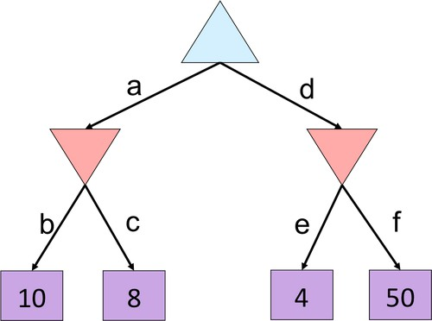
Alpha-Beta Quiz

Slide 31
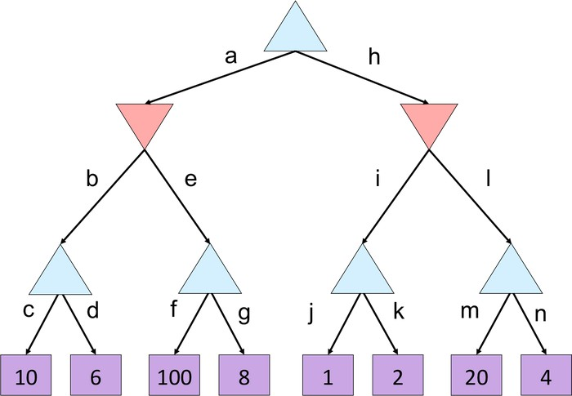
Alpha-Beta Quiz 2

Slide 32
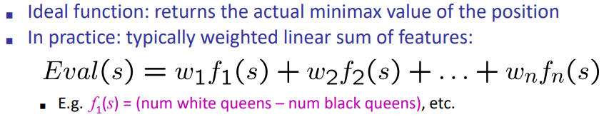
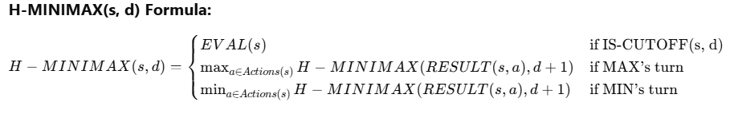
Heuristic AlphaBeta Tree Search

